Slide 1
Azure API Management
Divi Mishra
Cloud Solution Architect, App Innovation
divimishra@microsoft.com

Slide 2
Before we start
Please make sure to create an Azure APIM Developer Instance.
Takes 30-40 mins to complete deploying.

Slide 3
Agenda
Overview of Azure API Management
Users, products, and group
Developer Portal
Mock an API Response
Version & Revisions
Policies
API Caching
API Monitoring
Azure Functions as an API

Slide 4

Overview of API Management on Azure

Slide 5

Azure API Management
AZURE API MANAGEMENT
Facade
decouple
modernize
optimize
...
Middleware
secure
protect
cache
...
Monitoring
usage
health
monetization
...
Developer
discover
document
on-board
...
Notes:
First is APIM creates a public facade over your APIs and decouples API implementations or backends from API consumers enabling them to evolve independently. This includes hiding all APIs regardless of their location behind a single domain name and API address. Exposing only a subset of backend capabilities to API consumers. Modernizing and normalizing APIs by changing their URL structure and response formats. Optimizing APIs for specific consumers and scenarios by conditionally stripping down the responses. Dynamically routing requests to implement advanced versioning approaches
Second, APIM allows API implementers to externalize and centralize common cross cutting concerns and focus on the core value, the domain related logic. Security, throttling, cross domain access and response caching are just a few horizontal capabilities you'll get from APIM. APIM supports API key, JWT token validation as well as IP based authorization. We offer a number of cross domain techniques including full support for CORS. APIM implements distributed quota and rate limiting policies that allow a great degree of flexibility and scale. It comes with built in response cache and policies that allow fine grained control over what and how gets cached
Having insight into usage and health of your APIs is important and APIM captures metrics and provides key reports out of the box. For those customers who are looking to monetize their APIs we collect and offer via API data allowing them to implement a variety of subscription business models.
With APIM Developer portal you can treat internal and external developers the same way from the get go and provide them with a self service on-boarding experience, AP catalog, documentation, samples, and allow them to send request to your APIs without writing a line of code.
■ Know who API users are and engage them like customers. Whether the developers programming to one’s APIs are inside the organization or outside, knowing who they are is a foundation of API success. For an API provider that charges for API use, like Twilio and SendGrid, this is of course necessary for collecting revenue, but even for free access, as with New York’s and Chicago’s transit systems’ APIs, knowing API users enables greater understanding of how APIs are used and what direction to take APIs in the future. API users, whether they pay or not, should be engaged as customers.
■ Clarify the rules of API access. For reasons of capacity management and security, access to APIs is rarely unlimited. But customers (i.e., API users in this case) don’t like surprises, so the
rules for access must be clear, such as what data may be accessed and how many requests are allowed per minute or per month. is may include de nition of di erent access plans with di erent rules for di erent API users.
Make it easy to use the API. rough documentation, examples, and discussion forums, it must be easy for API users to understand the API, get answers to questions, test API usage, and migrate between API versions. Although REST services are needed for mobile, other styles of services may also be part of an enterprise API strategy (e.g., SOAP, message queuing).
Enforce the rules of API access. API providers must validate that incoming API requests are authorized and comply with the rules de ned by the access plan each API user is associated with.
Proactively manage API success by treating it as a product. Whether API users are internal, external, or both, to optimize the business value of an API, the API provider must treat it as a product with customers and a life cycle. Whether via basic reporting or advanced analytics, API providers must understand patterns of API access, including error rates that may indicate the
API is di cult to understand. New versions of the API need a smooth and managed rollout to API users.
■ Connect API access to functions and data within their technology estate. APIs deliver their value by connecting to the API provider’s data and applications. Some of these assets may be API- ready, while others may need some manner of integration connectivity to make them accessible.

Slide 6
Azure API Management
API consumers
AZURE API MANAGEMENT
Facade
decouple
modernize
optimize
...
Middleware
secure
protect
cache
...
Monitoring
usage
health
monetization
...
Developer
discover
document
on-board
...
APIs on Azure
Azure APIs
On-prem APIs
3rd party APIs

Slide 7



AZURE API
MANAGEMENT
APP DEVELOPERS
Developer Portal
DIRECT OR
VPN
BACKEND
APIs
APPS
Gateway
Hosted anywhere.
Developed using any technology.
API PUBLISHERS
Publisher portal
Notes:
APIM on Azure is provided as a fully managed cloud service. It has 3 key components.
Publisher portal is used by API publishers, people who own the APIs, to manage the APIs. On the Publisher portal one can add and edit APIs, configure API policies, view analytics, etc. Metadata and settings entered on the Publisher portal drive both the gateway and the developer portal. Management operations can be automated by using a comprehensive but easy to learn and use API.
Developer portal is turn key and shows auto-generated API catalog, interactive documentation and samples. Its look-and-feel and behavior can be customized to reflect customer brand and needs.
Gateway acts as a front door and mediates all the requests to your APIs, collecting usage and health data and applying policies configured via Publisher portal. It can connect to backends located anywhere and implemented and running on any technology stack either directly or via VPN. Gateway supports both Basic HTTP and mutual certificate authentication.

Slide 8
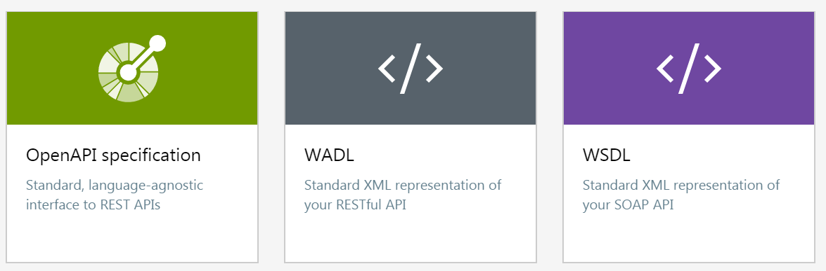
Import API Definitions

Slide 9
Lab 01
Objective:
Import, publish, and test an API with the Azure APIM Instance

Slide 10
Users, products, groups

Slide 11
Products
Products are how APIs are surfaced to developers.
Products can be Open or Protected. Protected products must be subscribed to before they can be used, while open products can be used without a subscription.
When a product is ready for use by developers, it can be published.
Subscription approval is configured at the product level and can either require administrator approval or be auto-approved.
Groups are used to manage the visibility of products to developers. Products grant visibility to groups, and developers can view and subscribe to the products that are visible to the groups in which they belong.

Slide 12
Groups
Purpose: manage the visibility of products to developers
Administrators - Azure subscription administrators
Developers - Authenticated developer portal users
Guests - Unauthenticated developer portal users, such as prospective customers visiting the developer portal of an API Management instance

Slide 13
Users, groups, products, APIs and subscriptions
1
1
1
many
1
many
many
many
1
0..1
User
Subscription
Product
API
many
many
many
many
Built-in: Guest, Developer, Admin
Custom: native or Azure AD
Group

Slide 14
Policies (more on this later)
Policies are a powerful capability of API Management that allow the Azure portal to change the behavior of the API through configuration.
Policies are a collection of statements that are executed sequentially on the request or response of an API.
Policy expressions can be used as attribute values or text values in any of the API Management policies, unless the policy specifies otherwise.
Some policies are based on policy expressions (examples in next slide)
Notes:
Azure API Management access restriction policies | Microsoft Docs

Slide 15
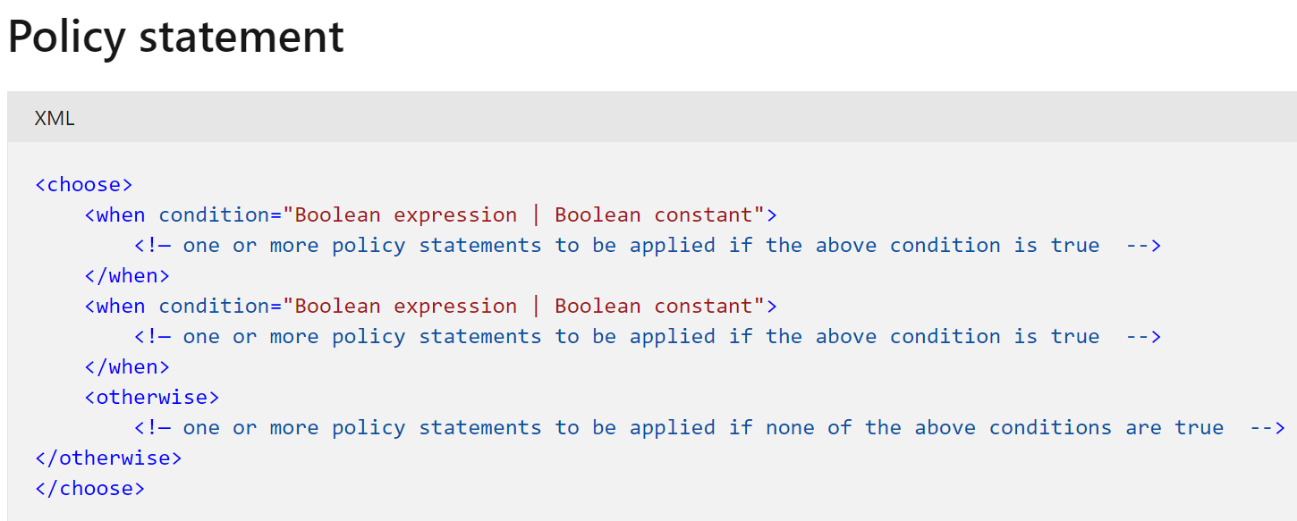
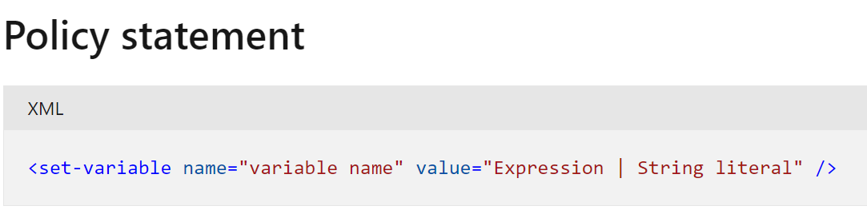
Policies based on policy-expression
Control flow:
Set variable:
Notes:
Azure API Management advanced policies | Microsoft Docs

Slide 16
Lab 02
Objective:
Create a product
Add a user group
Add a rate limiting policy to the product

Slide 17
Developer Portal

Slide 18
Developer portal
The developer portal is where developers can learn about your APIs, view and call operations, and subscribe to products.
The URL for your developer portal is located on the dashboard in the Azure portal for your API Management service instance.
You can customize the look and feel of your developer portal by adding custom content, customizing styles, and adding your branding.
Notes:
Developer portal - Frequently asked questions - Azure API Management | Microsoft Docs

Slide 19
Developer portal security
Username/Password
Internet identity providers:
Microsoft account
Google account
Facebook account
Twitter account
Delegated (custom)
Azure AD
Azure AD B2C
Developer portal
App developers
(use APIs)
Gateway
Admin console
Notes:
Developer portal - Frequently asked questions - Azure API Management | Microsoft Docs

Slide 20
Lab 03
Objective:
Create the developer portal with CORS
Registration to the portal
Testing APIs through the portal
Subscription to products

Slide 21
Mock an API response

Slide 22
API Mocking
Mocking = stimulating behavior of real API (but in a controlled manner)
Need it for quick feedback of testing
Helpful in validating issues across different versions of apps
If backend and UI development are happening in parallel, the UI needs a dummy response
You can mock your backend services

Slide 23
Lab 04
Objective:
Create a blank API
Create a mock response

Slide 24
Versions & Revisions

Slide 25
Versions
Versions allow you to present groups of related APIs to your developers.
Versions differentiate themselves through:
Version number (which is a string of any value you choose)
Versioning scheme (path, query string or header).
You can use versions to handle breaking changes in your API safely.

Slide 26
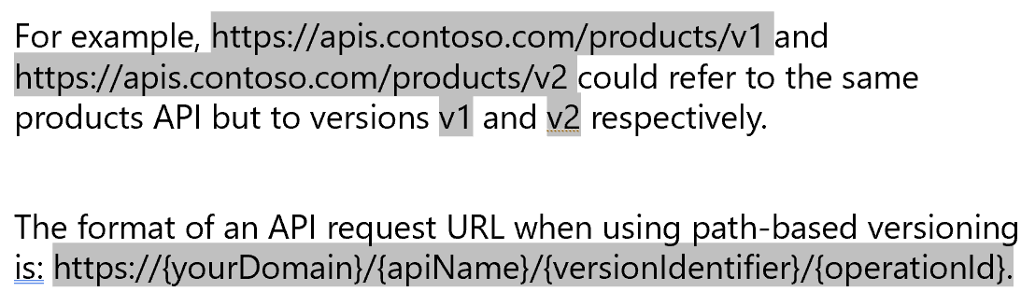
Example: Path-based versioning
When the path versioning scheme is used, the version identifier needs to be included in the URL path for any API requests.

Slide 27
Example: Query string-based versioning
When the query string versioning scheme is used, the version identifier needs to be included in a query string parameter for any API requests. You can specify the name of the query string parameter.
The format of an API request URL when using query string-based versioning is:
https://{yourDomain}/{apiName}/{operationId}?{queryStringParameterName}={versionIdentifier}
For example, https://apis.contoso.com/products?api-version=v1 and https://apis.contoso.com/products/api-version=v2 could refer to the same products API but to versions v1 and v2 respectively.

Slide 28
Revisions without versions
Service Instance
API
Operation
Revision
;rev=1
/speakers
/sessions
/days
https://example.org/
foo
;rev=2
;rev=3
;rev=4
offline
online
current

Slide 29
Versions and revisions
Operation
Service Instance
API
Version
Revision
/v1
;rev=1
;rev=2
/speakers
/sessions
/days
;rev=3
https://example.org/
foo
;rev=4
/v2
;rev=1
/events
/speakers
/sessions
/venues
;rev=2
offline
online
current

Slide 30
Accessing specific revisions
Each revision to your API can be accessed using a specially formed URL.
Append ;rev={revisionNumber} at the end of your API URL, but before the query string, to access a specific revision of that API.
For example, you might use this URL to access revision 3 of the customers API:
https://apis.contoso.com/customers;rev=3?customerId=123

Slide 31
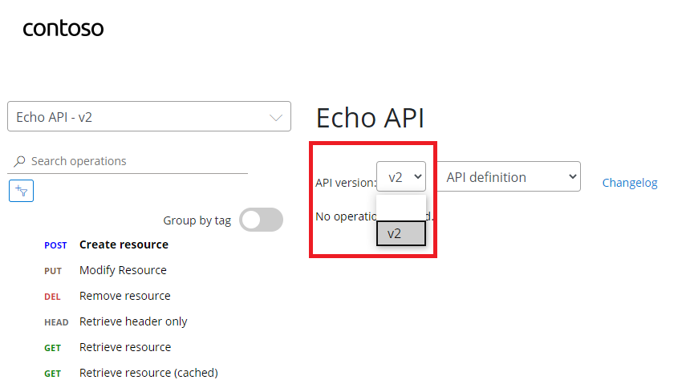
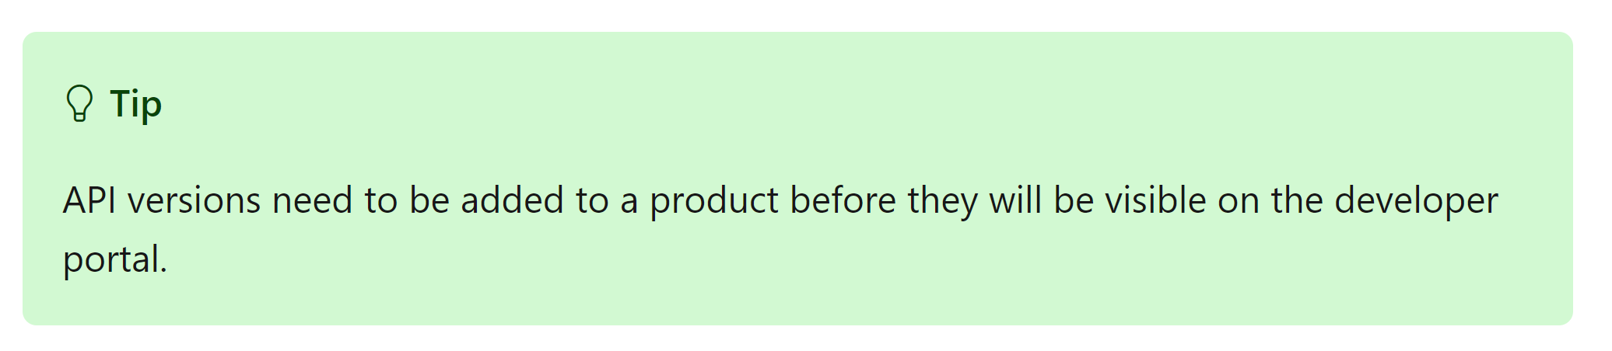
Developer portal
The details of an API also show a list of all of the versions of that API. An Original version is displayed without a version identifier.

Slide 32
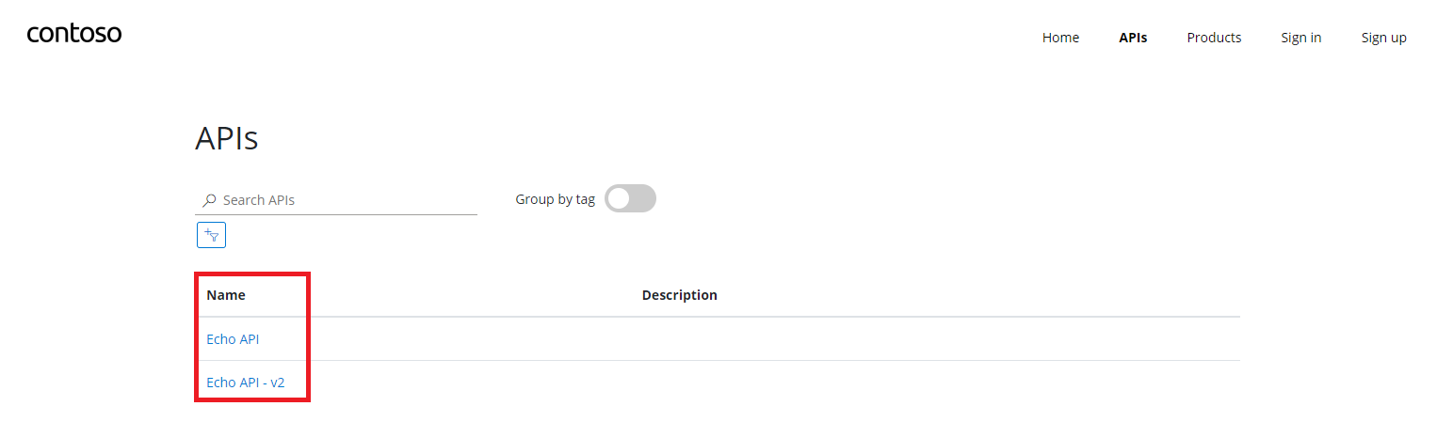
Developer portal
The developer portal lists each version of an API separately.

Slide 33
Lab 05
Objective:
Create and update a new revision
Create a new version

Slide 34
Policies

Slide 35
Understanding policy configuration
The policy definition is a simple XML document that describes a sequence of inbound and outbound statements.
The XML can be edited directly in the definition window.
A list of statements is provided to the right and statements applicable to the current scope are enabled and highlighted.
The configuration is divided into inbound, backend, outbound, and on-error.
<policies>
<inbound>
<!-- statements to be applied to the request go here -->
<rate-limit-by-key calls=“3” renewal-period=“60” counter-key=“@(context.Request.IpAddress)” />
</inbound>
<backend>
<!-- statements to be applied before the request is forwarded to
the backend service go here -->
</backend>
<outbound>
<!-- statements to be applied to the response go here -->
</outbound>
<on-error>
<!-- statements to be applied if there is an error condition go here -->
</on-error>
</policies>

Slide 36
Policy scopes
GET /foo/bar HTTP/1.1
Host: api.constoso.com
Key: 0123456789
global
CORS
LOG
0123456789
product
from caller
RATE
QUOTA
to backend
inbound
/foo
api
JWT
/bar
operation
CACHE
URL
BODY
to caller
from backend
outbound

Slide 37
Lab 06
Objective:
Add policy to strip HTTP Headers
Add policy to mask destination URL in content

Slide 38
API Caching

Slide 39
API Caching
APIs and operations in API Management can be configured with response caching
Significantly reduces latency for API callers and backend load for API providers

Slide 40
APIM Caching Policy
<cache-lookup/> and <cache-store/>
Caches response if it’s smaller than 2MB
Acts as server of origin – ignores cache control headers from backend and replaces them with own
With expressions possible to use cache control settings sent from backend
vary-by-developer and vary-by-group provide additional scope control
Can be configured to cache requests with Authorization header
Properly handles conditional requests e.g. if-match, if-modified-since
Cache hit ratio is provided as a metric
<cache-lookup-value> & <cache-store-value>
Entity to cache and a key are specified by expressions
TTL or LRU
Any policy change invalidates cache entries at that scope
<cache-remove-value/> removes an entry with a specified key
Notes:
Azure API Management caching policies | Microsoft Docs

Slide 41
Lab 07
Objective:
API Caching
Notes:
Use an external cache in Azure API Management | Microsoft Docs

Slide 42
API Monitoring

Slide 43
API Monitoring
As an API developer, you can view API statistics (that you have access to) on Developer Portal
You can create dashboards
Use Azure Monitor Logs with Log Analytics workspaces for ad hoc queries, monitoring, and custom reporting
Use Azure Application Insights for e2e tracing, live monitoring, troubleshooting

Slide 44
Lab 08
Objective:
API Dashboards in Developer Portal
API Dashboards in Azure API Management
Notes:
Use an external cache in Azure API Management | Microsoft Docs

Slide 45
Exposing an Azure Function as an API

Slide 46
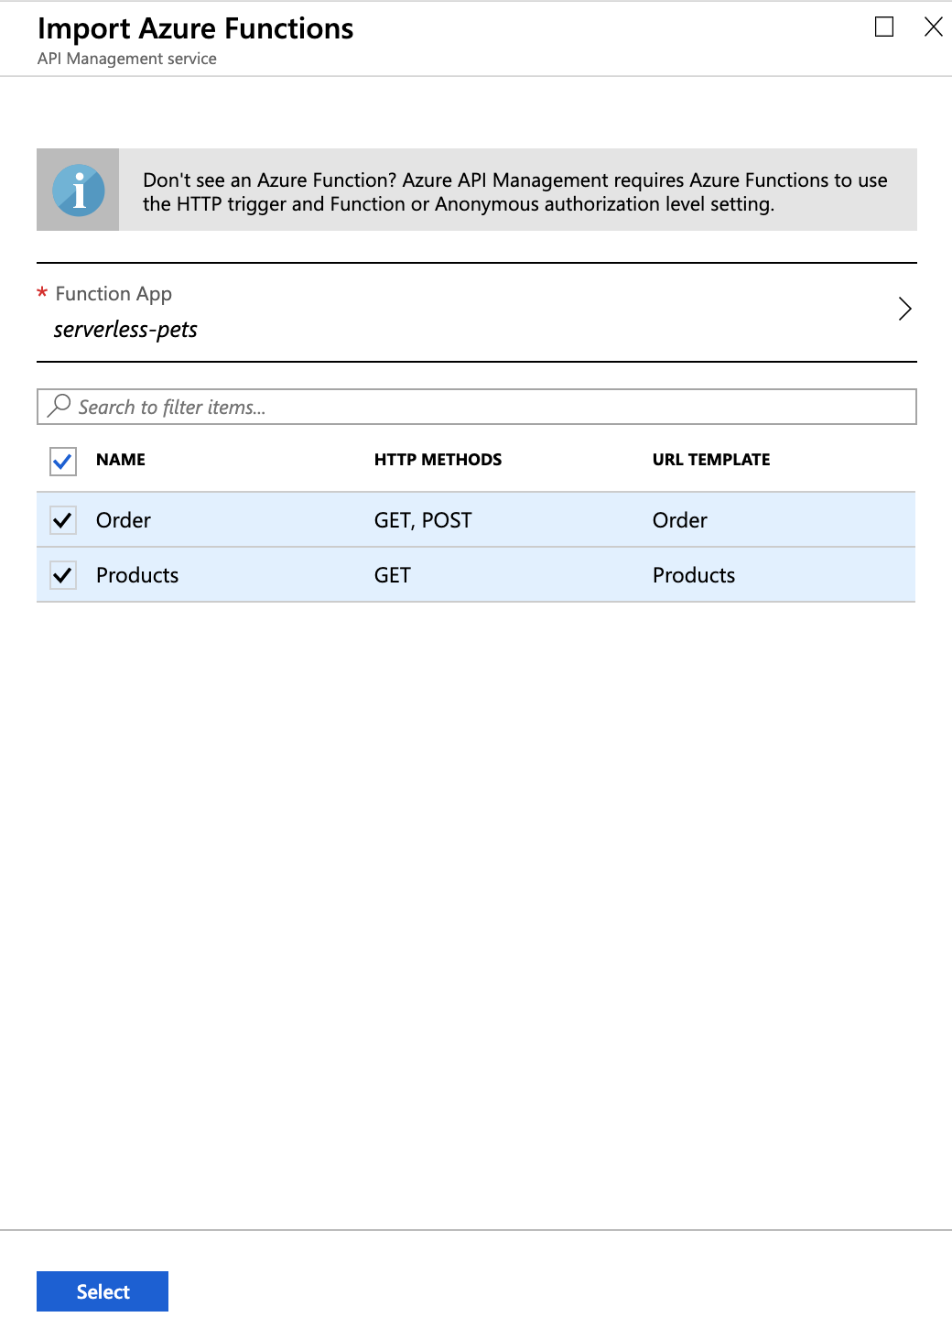
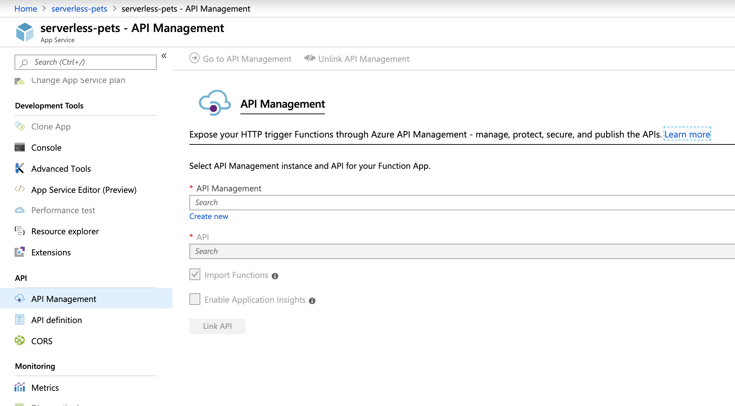
API Management Functions
Notes:
We improved integration with Functions.
Now, when importing a Function App you can pick the functions you want to import.
You can also expose a Function App as an API directly from the Function App blade.
In fact, we love Functions so much that we built a whole new Consumption tier optimized for use with Functions and other serverless resources.

Slide 47
Lab 09
Objective:
Create a function app
Expose the function as an API
Notes:
Use an external cache in Azure API Management | Microsoft Docs

Slide 48
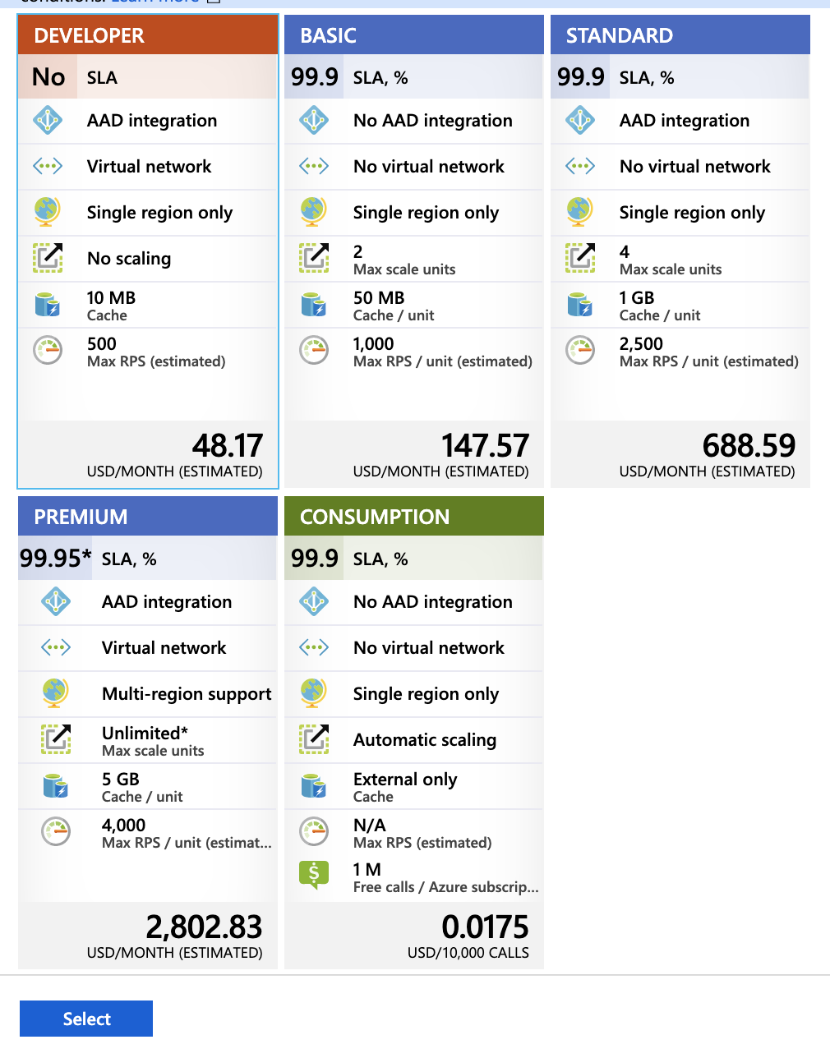
Tiers

